Slide 1
Status of Cleanup at Twin Cities Army Ammunition Plant (TCAAP)
U.S. Army Environmental Command
RAB Meeting
2-18-2025

Slide 2
AGENDA – February 18, 2025 at 7 P.M.
Old Business
Cleanup Status Update
  Round Lake
  Groundwater Remediation
  Per- and polyfluoroalkyl substances (PFAS)
  U.S. Geological Survey (USGS) Groundwater Model and Site K
New Business
Next Meeting Agenda
Public Comments

Slide 3
Old Business
Vote to accept the minutes from previous meeting.
Contract for Round Lake construction was awarded in August 2023. Round Lake Technical Working Group met on December 4th to discuss the 30% design and again on February 18th To discuss change in conditions. Date of next Round Lake Technical Working Group meeting to be determined.
Army held groundwater stakeholder meeting on 18 February 2025.

Slide 4
What has the Army done since September 2024?
Draft Final FY 2023 Annual Performance Report (APR) in regulatory backcheck.
Met with Groundwater Stakeholders on 18 February 2025.
Next Round Lake Technical Working Group (TWG) meeting date to be determined.
Source Area Hydraulic Evaluation Report of the TCAAP Groundwater Recovery System (TGRS) was finalized on October 14, 2024.
TGRS Operating Strategy Revision in process
Hydraulic evaluation of the TCAAP Groundwater Recovery System (TGRS) in process.
FY 2024 Annual groundwater sampling and land use control inspections completed. Draft Final FY24 Annual Performance Report submitted to regulators.

Slide 5
Round Lake
Remedial Design / Remedial Action
Update
Twin Cities Army Ammunition Plant: Round Lake
Arden Hills, Minnesota
Contract No. W9128F22D0002

Slide 6
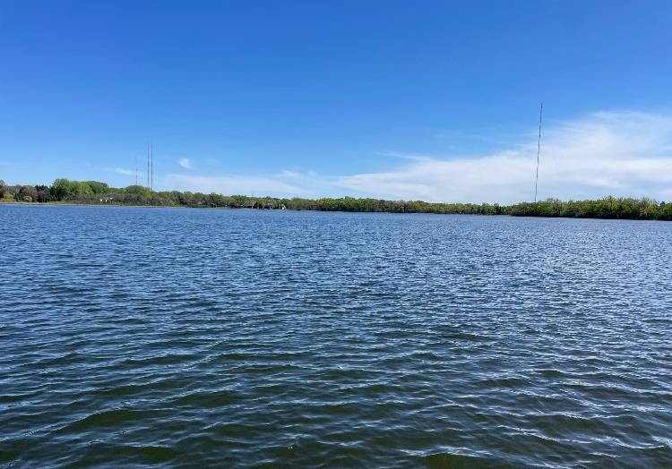
Agenda
Round Lake Remedial Action Overview
Additional Sediment Volume
Project Schedule

Slide 7
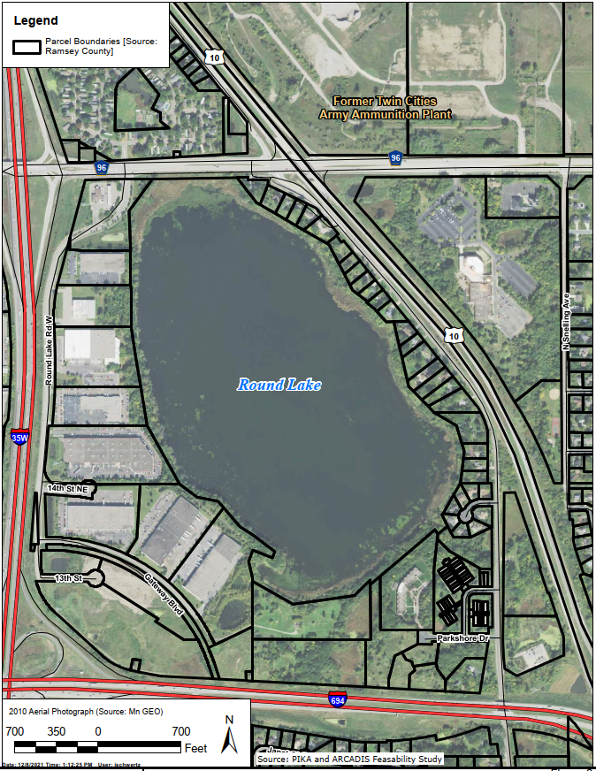
Round Lake Remedial Action
Sediment Processing
Lake Access
Dredging

Slide 8
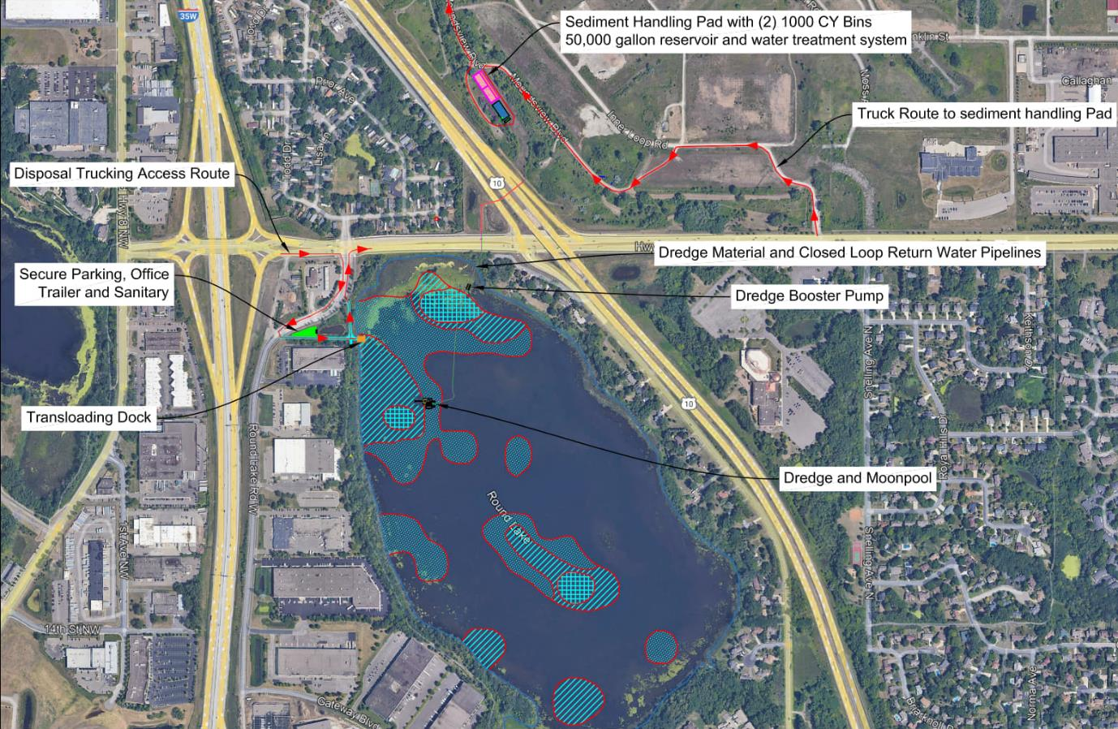
Round Lake Remedial Action
Sediment Handling Pad and water treatment system (holding tanks)
Planned Dredge Areas (Red Boundaries)

Slide 9
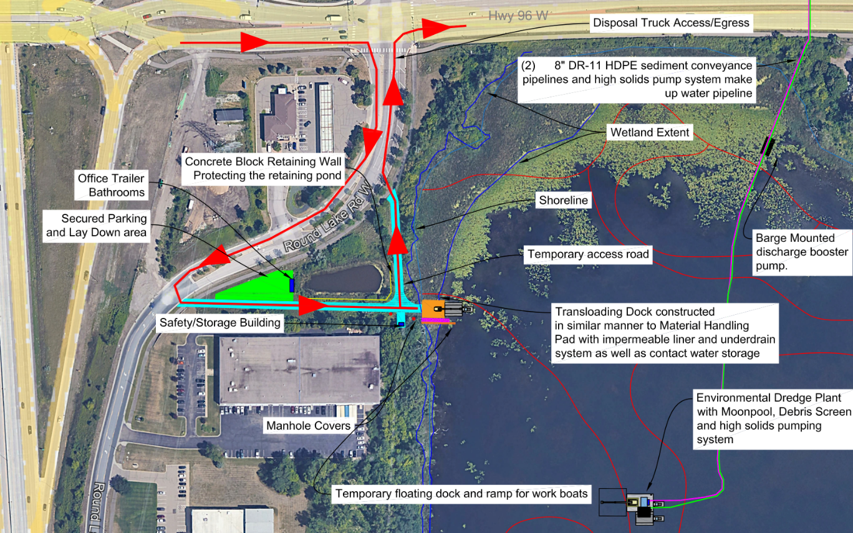
Round Lake Cleanup
Lake Access

Slide 10
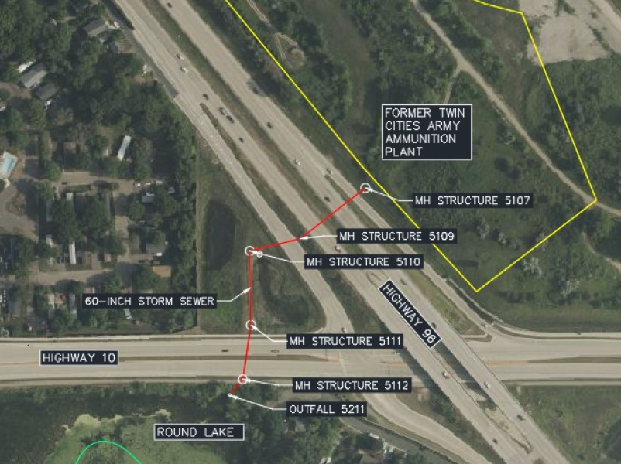
Storm Sewer Orientation
Dredged sediments will be transported to the TCAPP property via pipelines routed through the storm sewer

Slide 11
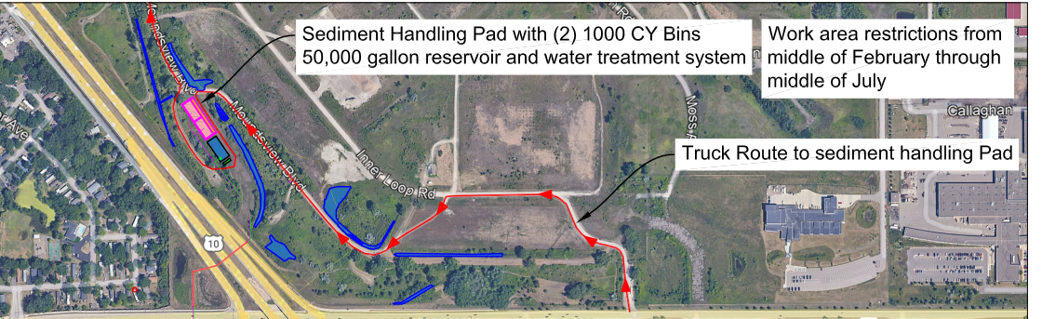
Round Lake Cleanup
Sediment Processing
Former Twin Cities Army Ammunition Plant

Slide 12
TWO OPTIONAL SLIDES IF WE PRESENT ALTERNATE SEDIMENT PROCESSING AREA

Slide 13
Round Lake Remedial Action
Dredging
ALTERNATE Sediment Processing
and
Lake Access

Slide 14
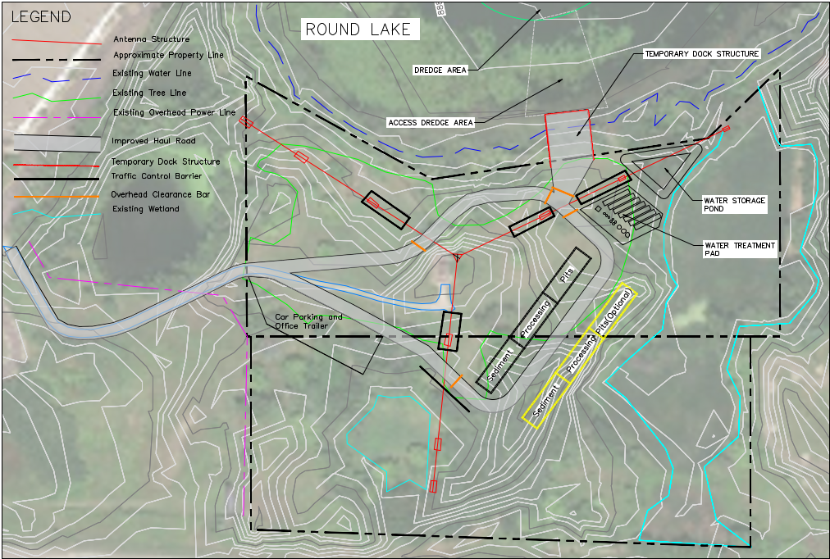
Round Lake Cleanup
Alternate Sediment Processing and Lake Access

Slide 16
Sediment Deposition in Round Lake
Previous Sampling Conducted in 2011
Basis for selected remedy in the ROD and associated sediment removal volume of 82,000 cubic yards
Reported Round Lake Sedimentation Rate
Greater than 1.5 centimeters (cm) per year
Estimated Deposition from 2011 to 2024
2024 – 2011 = 13 years x 1.5 cm/year
Greater than 19.5 cm (8 inches)
~ 74,000 cubic yards of additional sediment estimated to be present based on 2024 bathymetric survey results

Slide 17
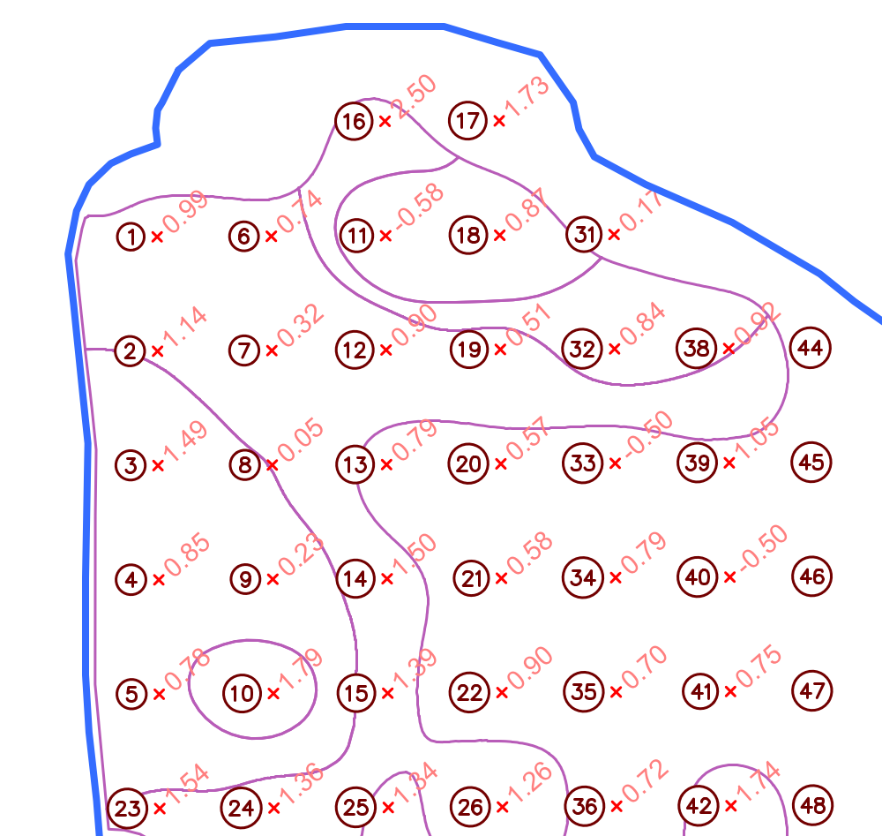
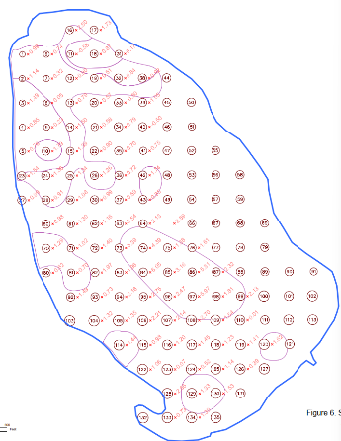
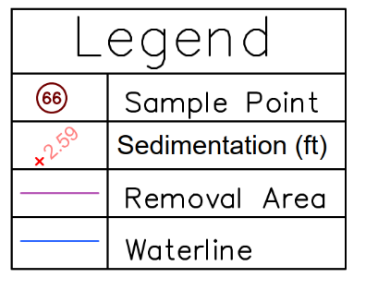

Lake Bottom Elevation Change, 2011 - 2024

Slide 18
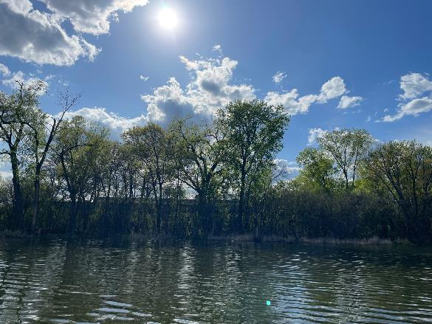
Round Lake Cleanup Schedule
Recent Activity
Preliminary Design Investigation Report
  Oct 2024 Draft Submitted
  Nov 2024 Comments Received / Addressed
  Feb 2025 Draft Final to be Submitted to
  Regulators
30% Remedial Design Report
  Aug 2024 Draft Submitted
  Sept 2024 Comments Received / Addressed
  Nov 2024 Draft Final Submitted to Regulators
  Jan 2025 Comments Received / Being Addressed
  Technical Meetings
  Dec 2024 Technical Workgroup Meeting
  Dec 2024 Technical Project Planning Meeting for 30% Remedial Design
  Feb 2025 Quality Assurance Project Planning Scoping Meeting

Slide 19

Round Lake Cleanup Schedule
Upcoming Activities
Remedial Design
  Quality Assurance Project Plan: late 2025
  60%, 90%, Final Design Reports: mid 2025 / early 2026
Remedial Action
  Vegetation Clearing (Nov 2025)
  Sediment Removal Activities (mid 2026 – 2027)

Slide 20
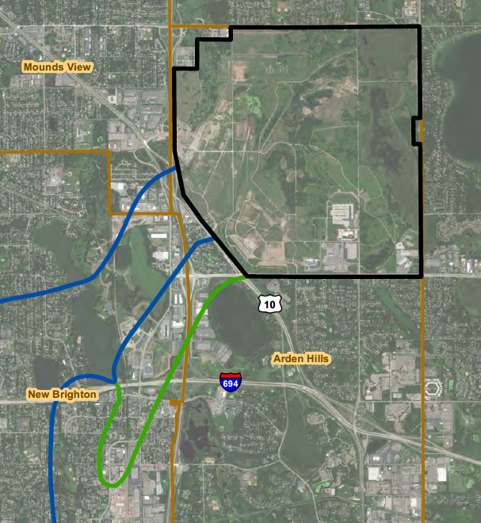
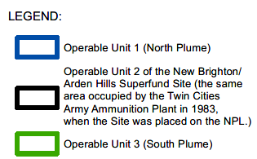
TCAAP Cleanup Status Update
Municipal Boundaries

Slide 21
Groundwater Sampling Update
Groundwater sampling allows the Army to monitor the plumes and update the maps.
Groundwater sampling (major year) completed in Summer 2024.
Groundwater data has been validated and incorporated into the Draft Final FY 2024 APR.
Annual plume maps are available in the respective APRs, most recently updated in the Draft Final FY 2024 APR.
Statistical evaluation of monitoring well network in process.

Slide 22
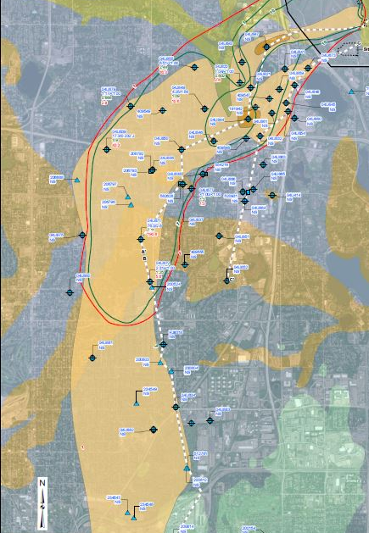
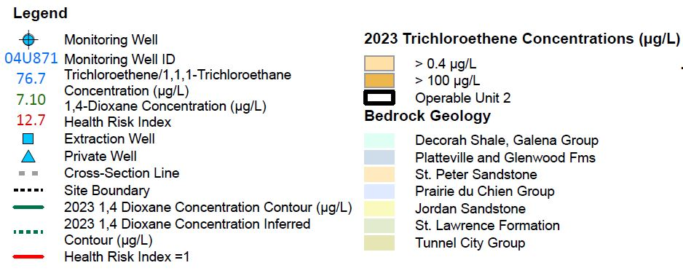
FY 2024 – Prairie du Chien Plume Map
Plume remains relatively stable compared to FY23 results.
Some minor fluctuations (both increases and decreases) spread throughout the plume.
Higher concentration area (>100ug/L) remains as two distinct lobes (shown on next slide), consistent with FY23 results.

Slide 23
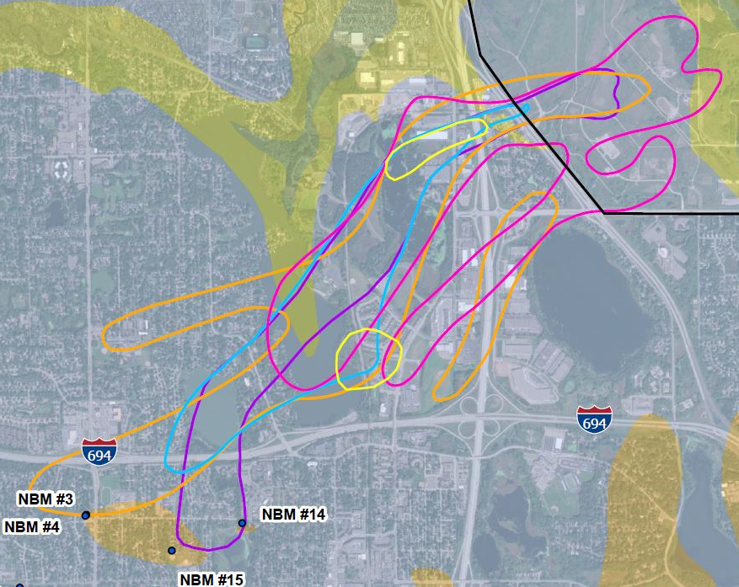
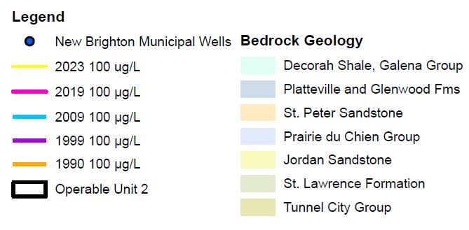
FY 2024 – Prairie du Chien Plume Map Over Time

Slide 24
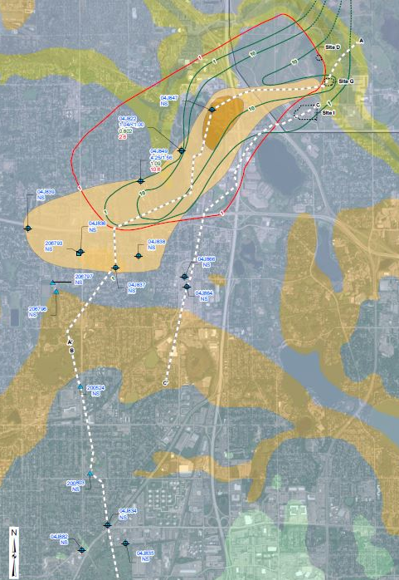
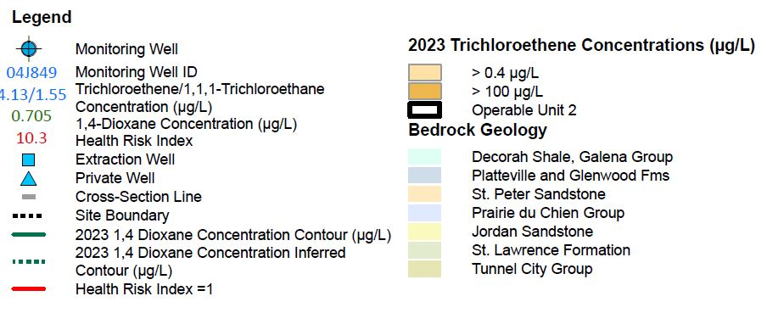
FY 2024 – Jordan Plume Map
Main plume remains relatively stable compared to FY23 results.
Downgradient wells non-detect in FY24 (most not sampled in FY23).
Higher concentration area not sampled in FY24.

Slide 25
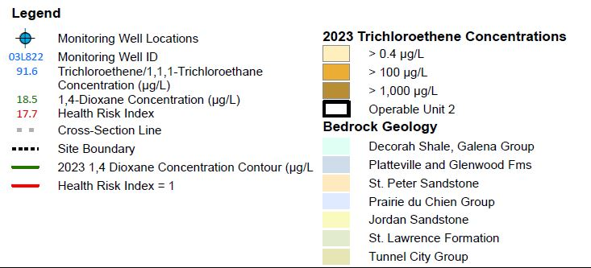
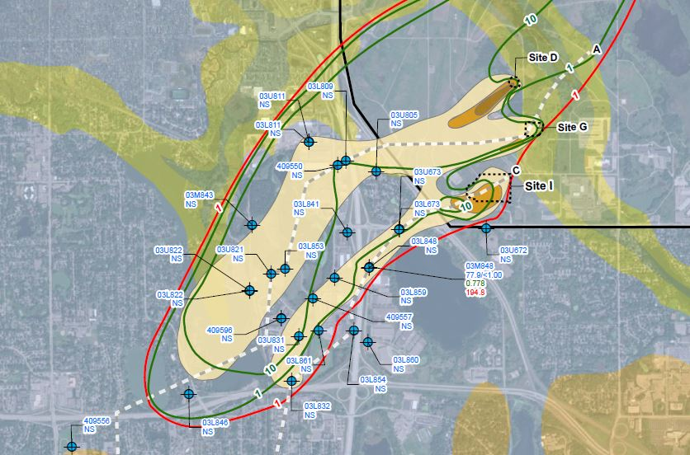
FY 2024 – OU2 Unconsolidated Sediments Plume Map
Plume remains relatively stable compared to FY23 results.
Appears mid-concentration (>100ug/L) area has split and migrated slightly.
Higher concentration area (>1,000ug/L) consistent with FY23 results.

Slide 26
Twin Cities Army Ammunition Plant Cleanup
Off-Post
OU1
Municipal Boundaries

Slide 27
OU1 Optimization
No change since last meeting.
Goal: increase amount of contaminant removed by relocating well more central to plume.
Optimization identified a need for a new well in New Brighton.
Funding was sent to New Brighton in September 2024 for both continued operations and installation of new well.
Anticipate installation going out for bids in March 2025.

Slide 28
Twin Cities Army Ammunition Plant Cleanup
On-Post
OU2
Municipal Boundaries

Slide 29
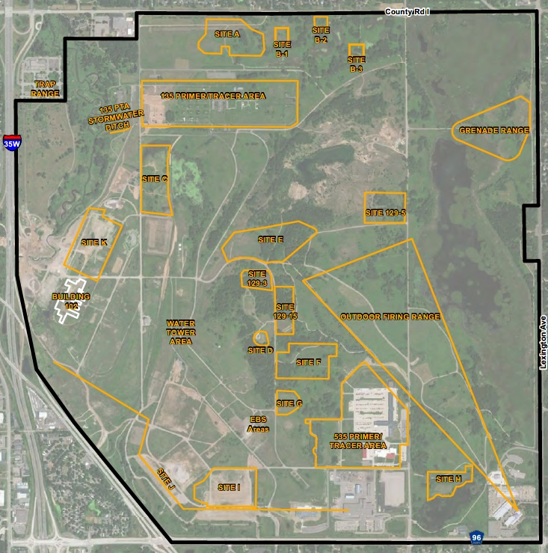
OU2

Slide 30
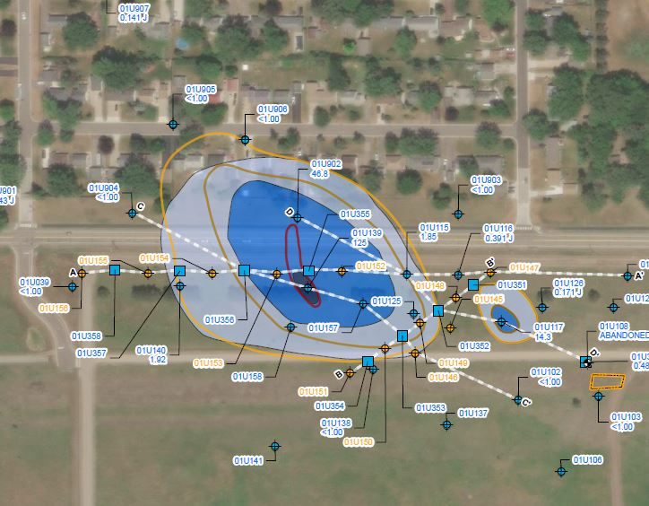
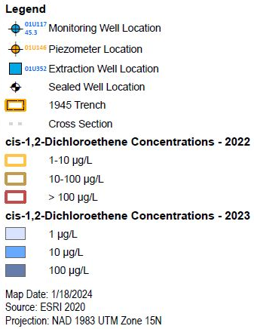
OU2 – Site A Monitored Natural Attenuation

Slide 31
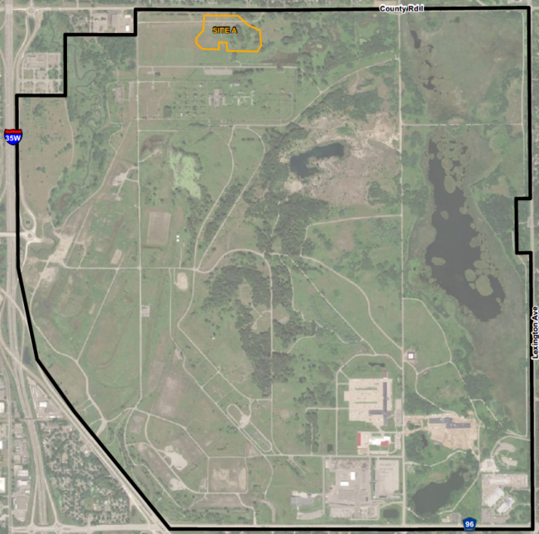
OU2 – Site A Monitored Natural Attenuation
Main plume (FY 2024) relatively stable compared to FY 2023.
Concentrations within the heart of the smaller plume have decreased from FY 2023.

Slide 32

OU2 – Site C Monitored Natural Attenuation
One location exceeds cleanup level compared to three locations in FY 2023.
Plume shrank back to FY 2022 levels.
Continue monitored natural attenuation.

Slide 33
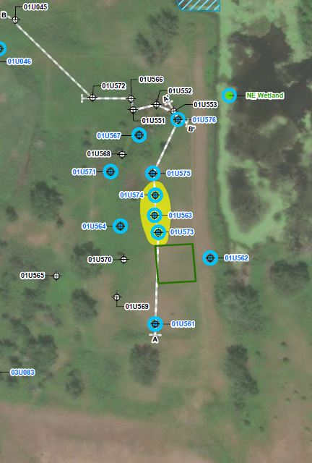
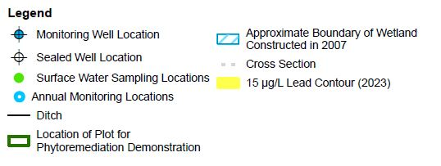
OU2 – Site C Monitored Natural Attenuation

Slide 34
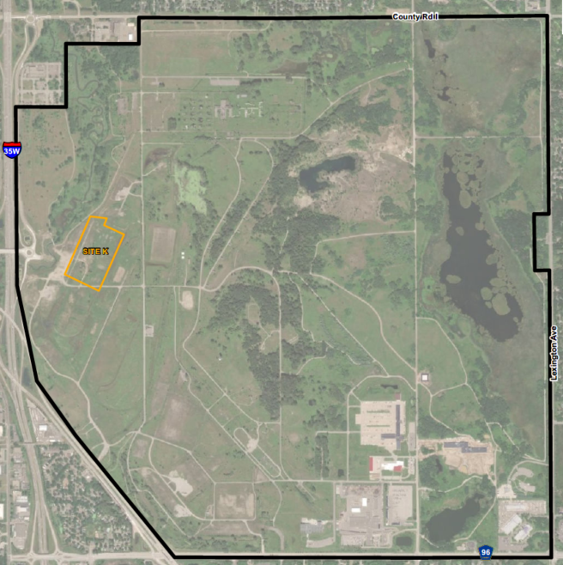
OU2 – Site K Pump and Treat
Groundwater collection system continues to provide containment of the horizontal and vertical extent of the TCE plume.
In May 2024, a telemetry system was
added to the Site K treatment system.
Automated notifications and remote
access to system data facilitated
faster response times. Increased
groundwater extraction volume &
treatment (by air stripping).
June 2024 groundwater sample results
confirmed trend of stable or
decreasing TCE over 20+ years
Notes:
GHD

Slide 35
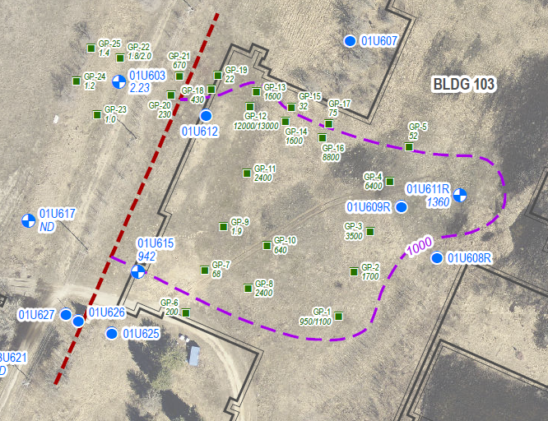
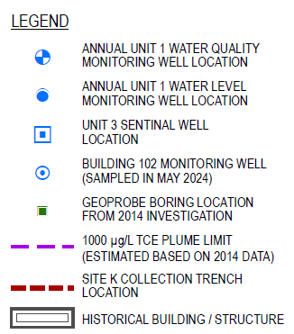
OU2 – Site K Pump and Treat
Notes:
GHD - Updated with FY24 APR figure. Plume consistent with FY 2023.

Slide 36
OU1/OU2 Well Abandonment and Reinstallation
Abandonment of three industrial wells in OU1 and 42 monitoring wells in OU2.
Reinstallation of four monitoring wells in OU1 and one monitoring well in OU2.
Monitoring well reinstallation in OU1 pending successful right-of-entry negotiations.
All activities planned for FY 2025.

Slide 37
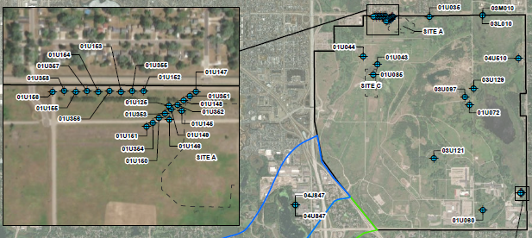
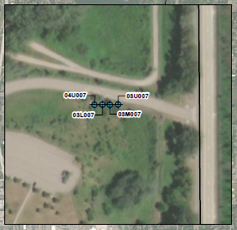
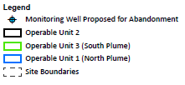
OU1/OU2 Well Abandonment and Reinstallation

Slide 38
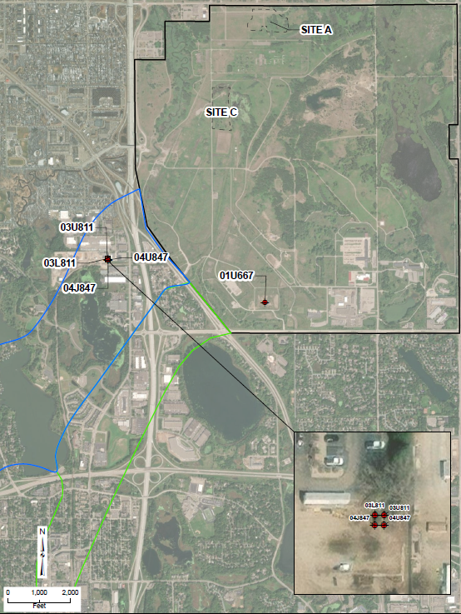
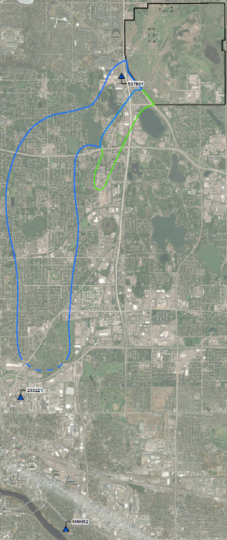


OU1/OU2 Well Abandonment and Reinstallation

Slide 39
Twin Cities Army Ammunition Plant Cleanup
Municipal Boundaries
Off-Post
OU3

Slide 40
OU3 Plume
OU3 plume remains relatively stable – results consistent with FY2023.
Continued monitored natural attenuation.
Annual groundwater sampling completed in June 2024
Notes:
EA to update image and legend with FY 2024 APR content

Slide 41
Update on the Deep Groundwater TCAAP Groundwater Recovery System (TGRS)

Slide 42
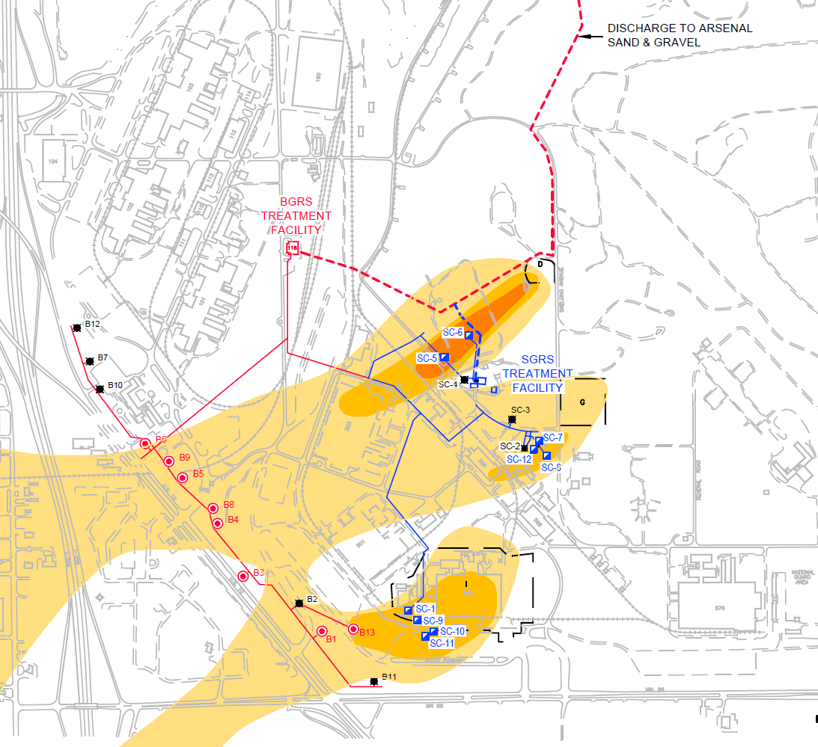
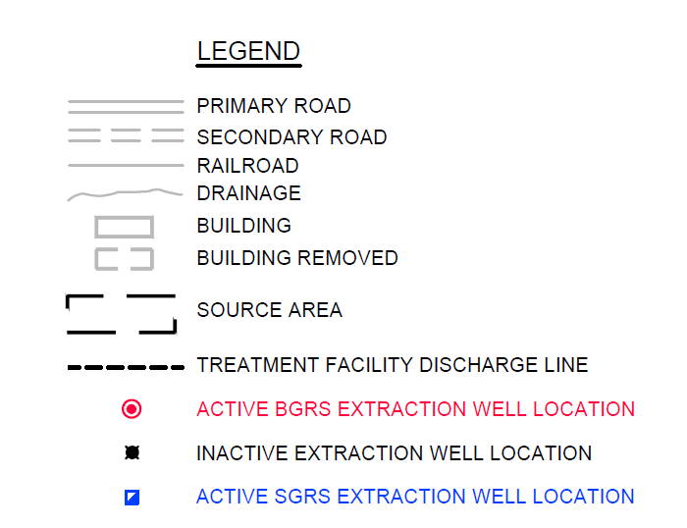
OU2 Optimization – TGRS Layout – TCE
Boundary Groundwater Recovery System (BGRS)
Source Area Groundwater Recovery System (SGRS)
BGRS + SGRS = TGRS
TCE PLUME 5-100 ug/L
TCE PLUME 100-1000 ug/L
TCE PLUME 1000+ ug/L
Notes:
GHD

Slide 43
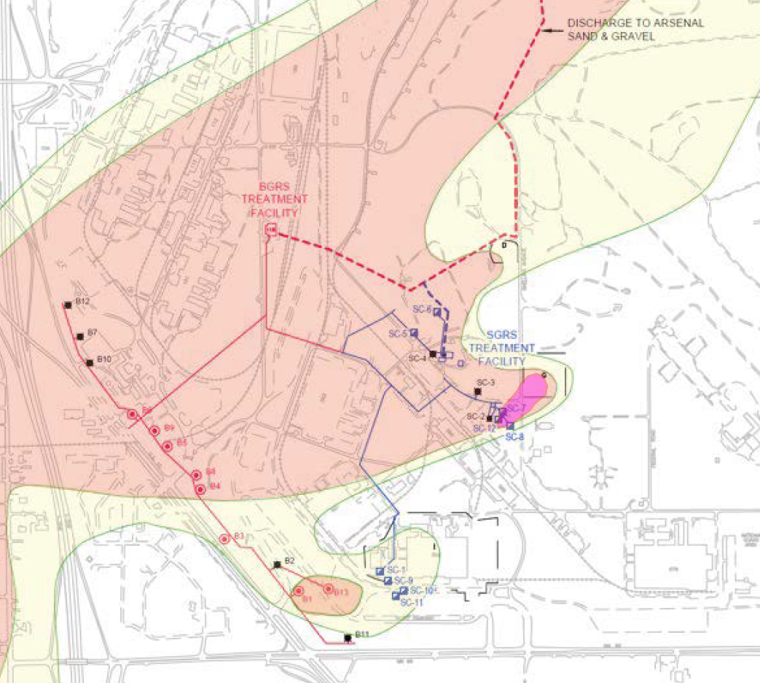
OU2 Optimization – TGRS Layout – 1,4-Dioxane
Boundary Groundwater Recovery System (BGRS)
Source Area Groundwater Recovery System (SGRS)
BGRS + SGRS = TGRS
Notes:
GHD

Slide 44
OU2 Deep Groundwater Remediation – FY2024
Total TGRS Operation Update
The Fiscal Year 2024 annual average extraction rate (BGRS + SGRS) was approximately 1,901 gal per minute (gpm), well above the Global Operating Strategy (GOS) Operational Minimum of 1,745 gpm.
GOS is based on the 2001 TCE plume concentrations
FY24 TCE plume width is ~17% narrower than the FY 2001 plume. TCE contained by TGRS during FY 2024.
In FY24, the BGRS pumped > 820M gallons and removed almost 300 lbs of VOCs; and the SGRS pumped >180M gallons and removed over 1,400 lbs of VOCs.
Upcoming: FY 2025 TGRS Operating Strategy Revision to optimize contaminant removal & more efficiently sustain hydraulic containment of the source areas.
Notes:
GHD

Slide 45
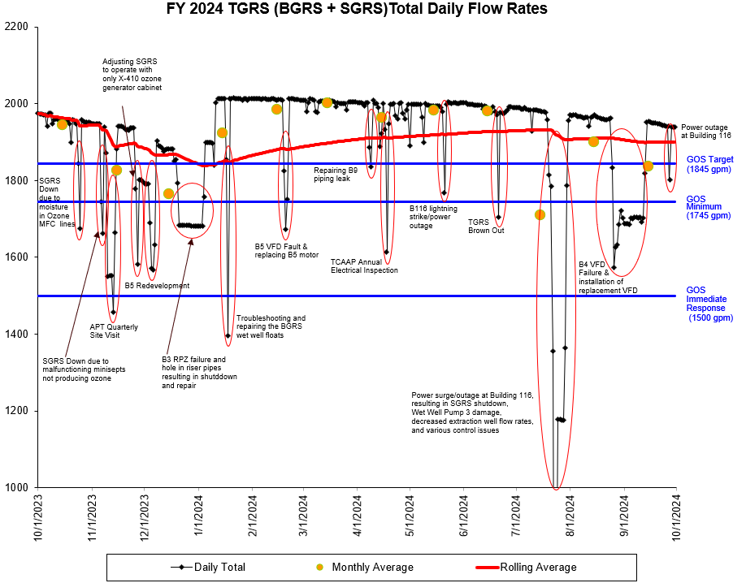
FY 2024 Daily Flow Rates
Notes:
GHD

Slide 46
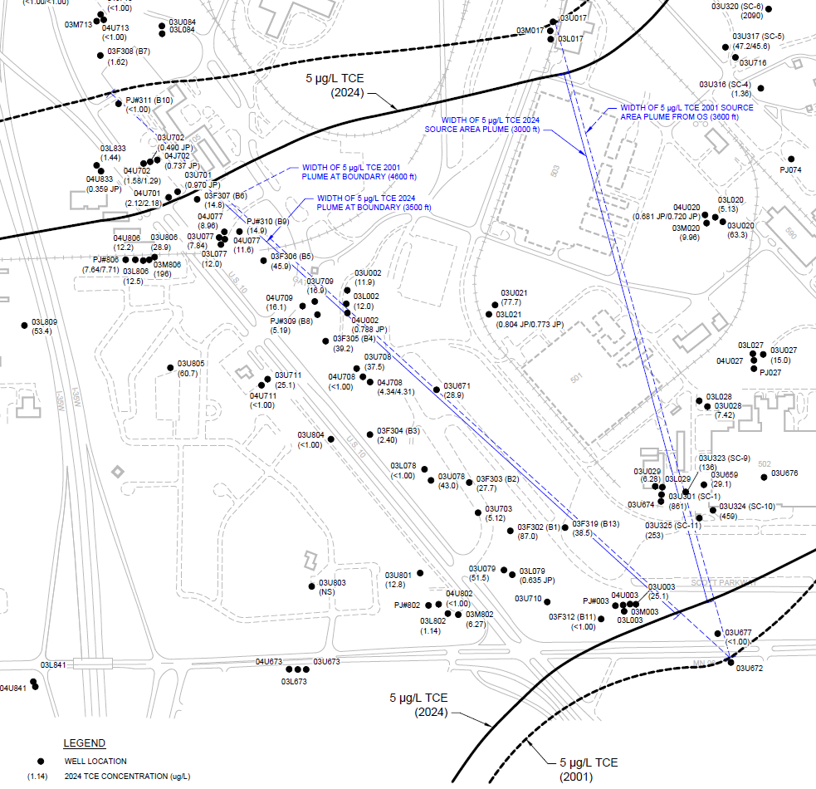
2024 TCE Plume (3,000 feet wide)
Notes:
GHD

Slide 47
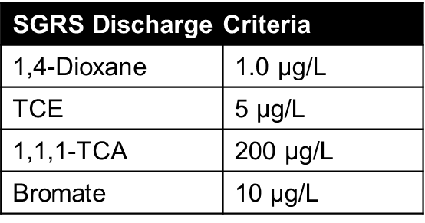
TGRS, SGRS Update
SGRS (Source Area) System Operation – AO + Air Stripper
System is operating and meeting all 1997 OU2 ROD and 2020 ESD #3 discharge criteria in monthly sampling since start up, including:
Full treatment to criteria of 1,4-dioxane and TCE in AO reactor; air stripper only needed for chlorinated alkanes
Since the SGRS began operation, influent TCE and 1,4-Dioxane concentrations decreased by over 60%. TCE and 1,4-Dioxane concentrations in the individual SGRS extraction wells also decreasing.
Notes:
GHD

Slide 48
SGRS Air Emissions
SGRS startup sampling results:
Measured contaminants were much less than those assumed/modeled in April 2021
  No detectable ozone (previously assumed @ 0.18 lb/hr),
  TCE into air stripper less than 5 ug/L (vs. assumed @ 32 ug/L)
Confirmed through MPCA screening model that SGRS air emissions are below State of Minnesota inhalation risks levels for acute, subchronic, chronic, and cancer exposures for at National Guard fence line.
Notes:
GHD

Slide 49
TGRS, BGRS Update
BGRS (Boundary) System Operation – Air Stripper
System is operating and BGRS Effluent samples met all 1997 OU2 ROD discharge criteria in monthly sampling completed during FY 2024.
  TCE all less than 5 µg/L limit
  All other contaminants of concern were non-detect (<1.0 µg/L)
  BGRS VOC influent concentrations were consistent from FY 2023 to FY 2024 - Averaging ~44 µg/L
Notes:
GHD

Slide 50
BGRS Air Emissions
Development activity has not begun in this area and there are currently no receptors. Modeling and sampling completed in 2020.
80% reduction in TCE influent concentrations at BGRS since SC-5 and SC-1 were rerouted from BGRS to SGRS. Influent TCE reduced from 201 µg/L in 2020 to less than 40 µg/L in 2024.
TCE emission rate through Dec 2024 = 0.0036 g/s
(2020 modeled emission rate = 0.005 g/s).
Additional air sampling and modeling will be completed for BGRS emissions once new TGRS operational flow rates are established.
Notes:
GHD

Slide 51
PFAS
A Preliminary Assessment and Site Inspection (PA/SI) was finalized in September of 2023.
In July of 2024, the Army received a joint letter from EPA and MPCA disagreeing with the number of Areas of Potential Interest (AOPIs) moving forward to a Remedial Investigation and Feasibility Study (RI/FS).
In November of 2024, a discussion between USAEC and EPA was held to discuss a path forwards, this includes a supplemental screening and sampling event to identify sites potentially missed during the PA/SI. This effort will be combined with the RI/FS contract.
In January 2025, the Department of Defense adopted new screening levels for PFAS. Due to this two additional AOPIs have been added to the RI, the Southwest Sewer System (Site J) and the Open Burn Area/Salvage Area (Site C).
A RI/FS contract is currently being built with an expected award during 4th quarter FY25 pending funds availability.

Slide 52
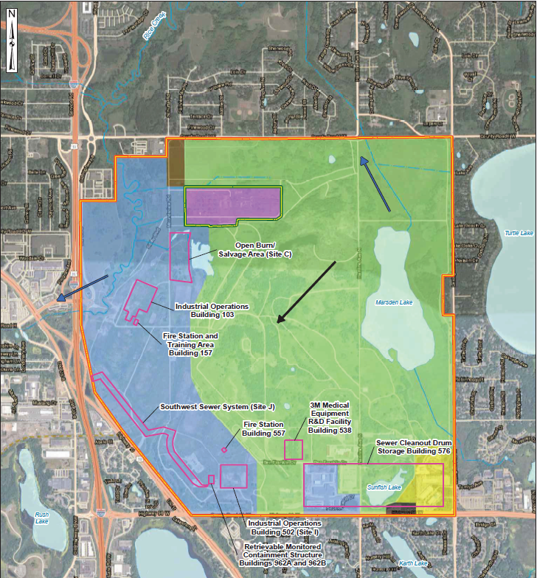
Map of AOPIs
Current PFAS AOPIs
Building 103
Building 157
Building 502
Building 576
Site C
Site J

Slide 53
Additional Presentations
USGS Groundwater Model Update

Slide 54
What’s Next
OU1
  Optimization identified a need for a new well in New Brighton.
  Begin industrial well abandonment (3 wells).
  Begin installation of 4 monitoring wells.
OU2
  Begin abandonment of 42 monitoring wells.
  Begin installation of 1 monitoring well including optimization of the monitoring well network.
  Begin Risk Assessment for unrestricted land use.
  135 Primer Tracer Area – sold.
OU3
  Continue groundwater monitoring.
Round Lake
  Continue remedial design.
Administrative Record/Information Repository
  Army working with Arden Hills Army Training Site (AHATS) to enlarge space.

Slide 55
New Business
Recommend next RAB meeting 16 September 2025.
Topics for future RAB meetings?
Additional administrative requirements for RAB?
Suggestions for improvement of RAB?

Slide 56
Next Meeting Agenda
Review/Approve minutes of last meeting
Old Business
Cleanup Status Update
New Business
Next Meeting Agenda
Public Comments

Slide 57
Public Comments
Does anyone have any comments, concerns or suggestions

Slide 58

Questions
You can ask questions now or at anytime using the email listed on the website.

Slide 59
Slide Title Goes Here

